Slide 1
Topic 07: Data Accessibility
BDM3302: Data Management

Slide 2
What is Data Accessibility?
Data accessibility is the degree to which people in an organization can access and use data.
Data accessibility determines the extent to which data consumers in an organization can access and utilize data to achieve the organizational goals, increase productivity and efficiency without requiring advanced know-how and experience in working with data.
Data is not just available, but it is also usable. It’s not enough to know that the data lives in some platforms. If someone in your organization really needed it, they could submit a request for a very specific report.

Slide 3
What is Data Accessibility?
Data accessibility is the on-demand, authorized capability to retrieve, modify, copy, or move data from IT systems. With data access, users can perform these activities from any location.
Data access is the means by which users can access this data in an authenticated manner approved by the organization that owns the data.
Data accessibility is one of the main outputs of an effective data governance program. Ideally, organizations should think through structured approaches to grant data access to various stakeholders, both internal and external to the organization.

Slide 4
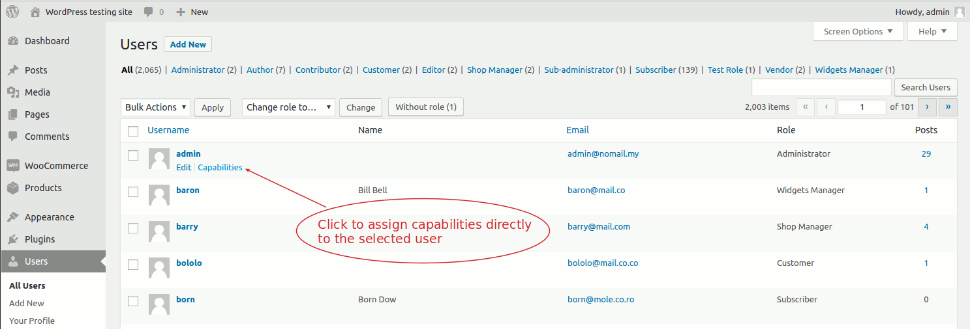
User and Role Management

Slide 5
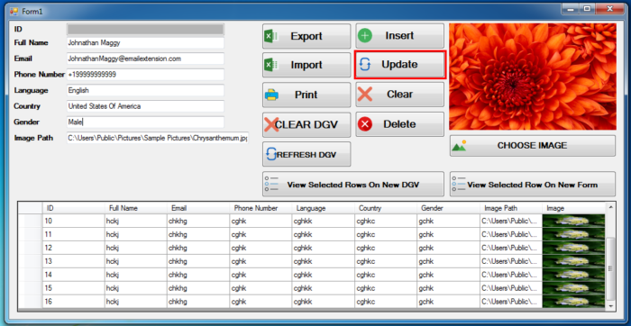
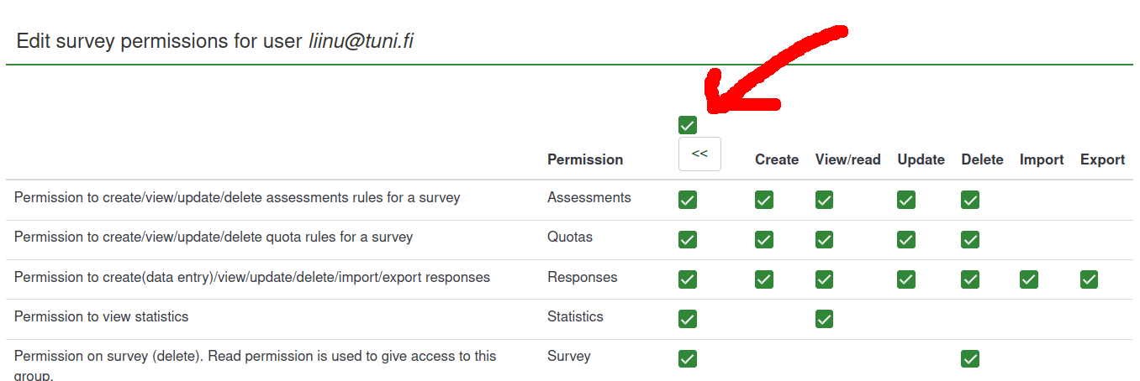
Permission

Slide 6

Data Modeling Tool (Reminding)
DBM Tool v.1.2.2 by Dr. Anan Osothslip (Download from LMS and unzip file)
It is the tool that introduces how data can be constructed and converted into the SQL and database tables
The input can be JSON only that process the output into SQL and database tables
This tool also provides catalog, departments, roles, positions, users, processes, and assets in order to identify what kind of these data to support your business (will use in Data Accessibility lab class later)
The Internet connection is also required for this tool

Slide 7
Data Modeling Tool (Reminding)
For Data Accessibility, there are the menus provided below:
Catalog
Data Element Catalogs
General Information
Business Detail
Business Assets
UI
Departments
Roles
Positions
Users
Processes [NO NEED]
Assets

Slide 8
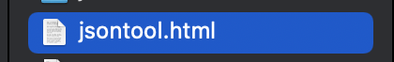
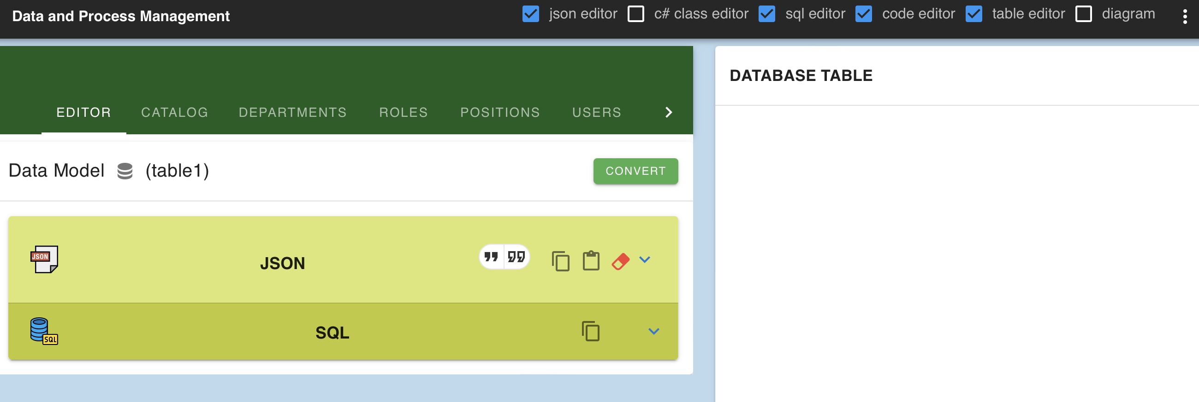
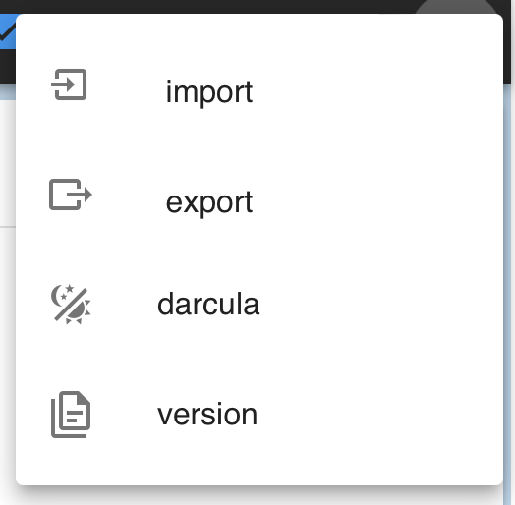
Data Modeling Tool Overview (Reminding)
Please uncheck this check box first!
Double click to open
Import/Export file
Menu Selection
Data Model Name
Convert button
JSON Input Area
SQL Output Area
Database Table Output Area

Slide 9
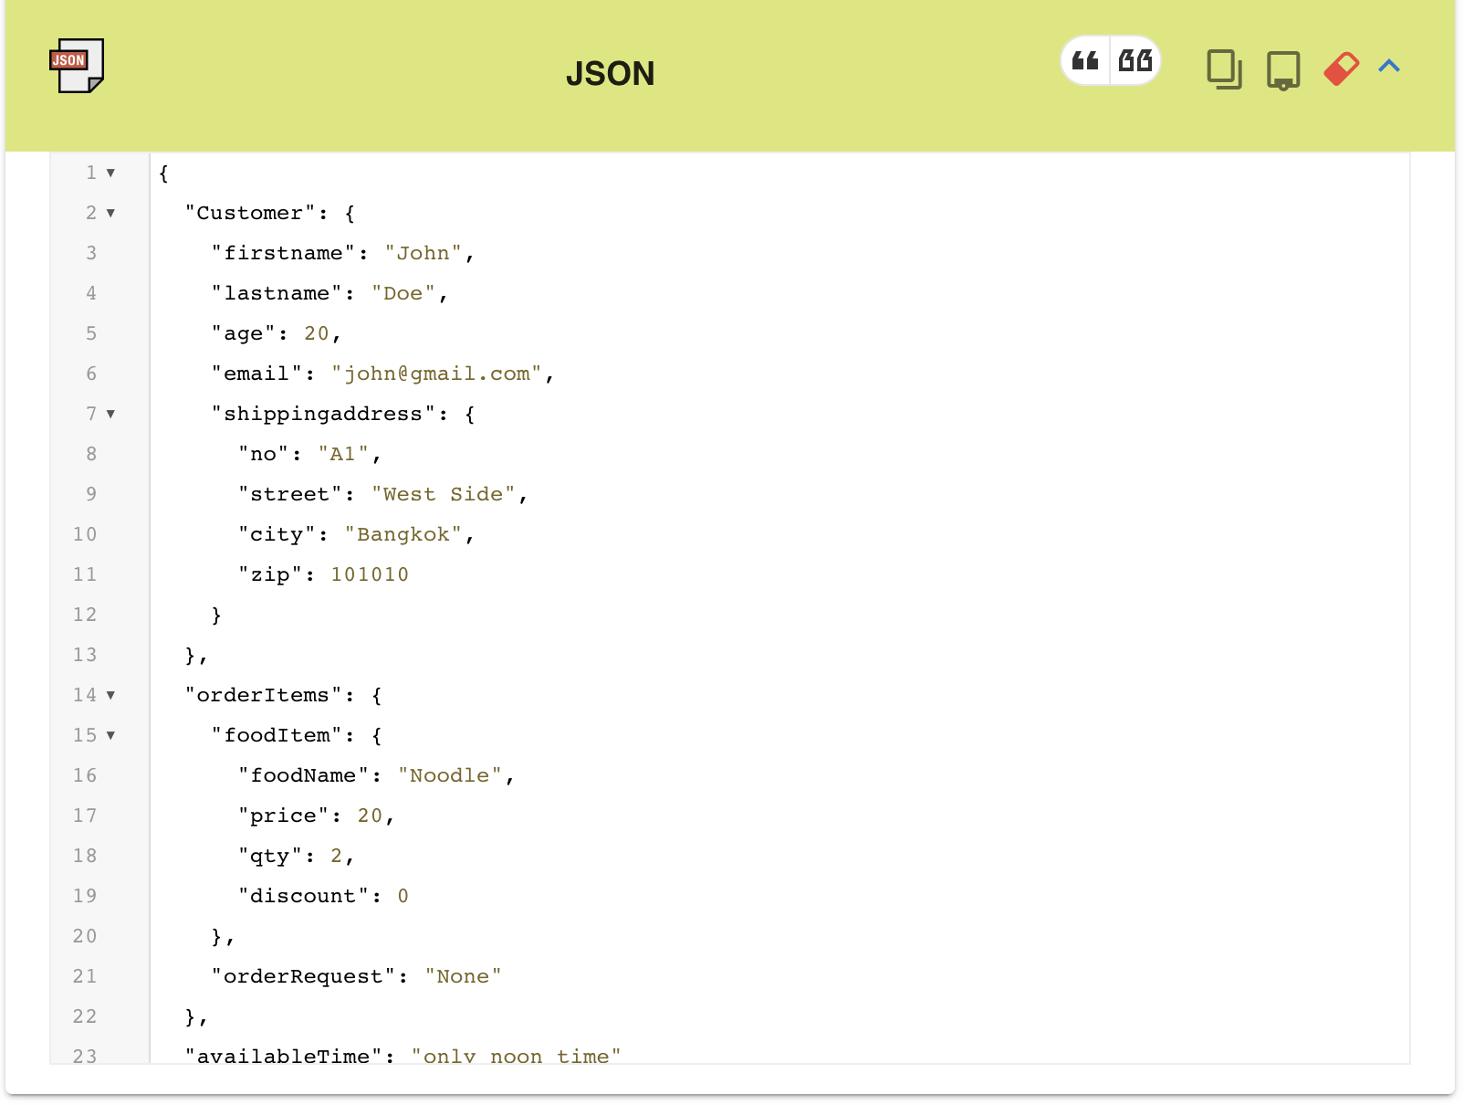
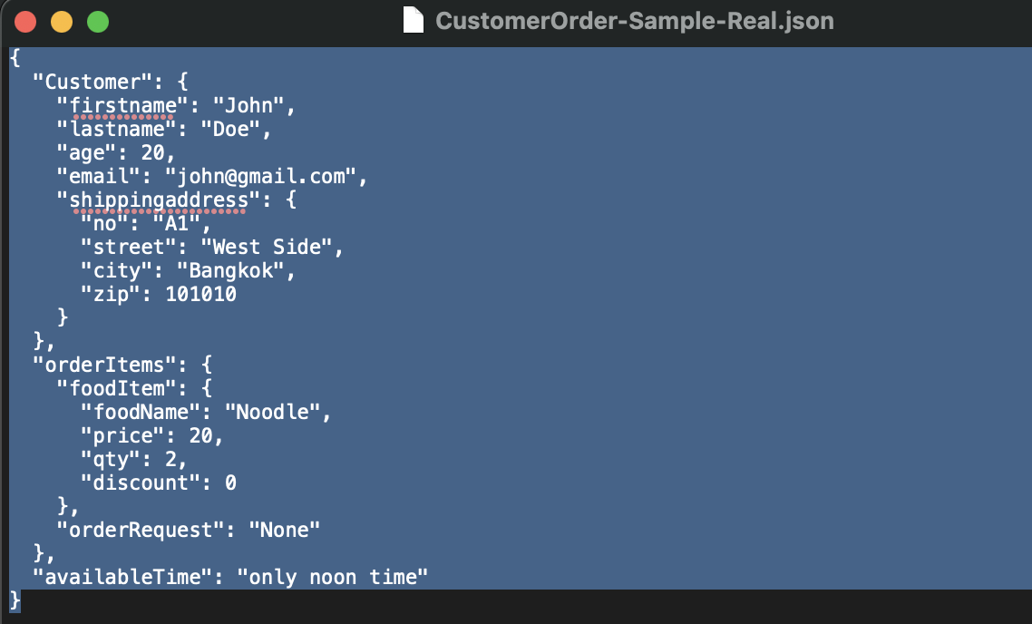
Data Modeling Tool (Data Accessibility Lab)
First, let’s try to import the “CustomerOrder-Sample-Real.json” file from LMS (Open file in Note Pad or any Text Editor and then copy and paste into JSON Input Area)

Slide 10
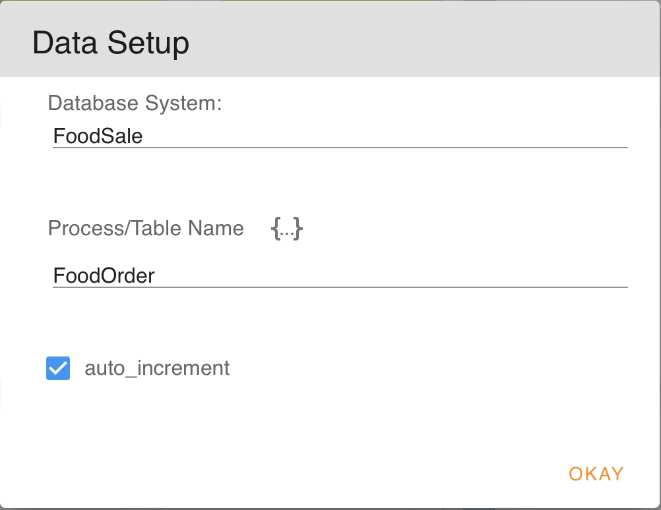
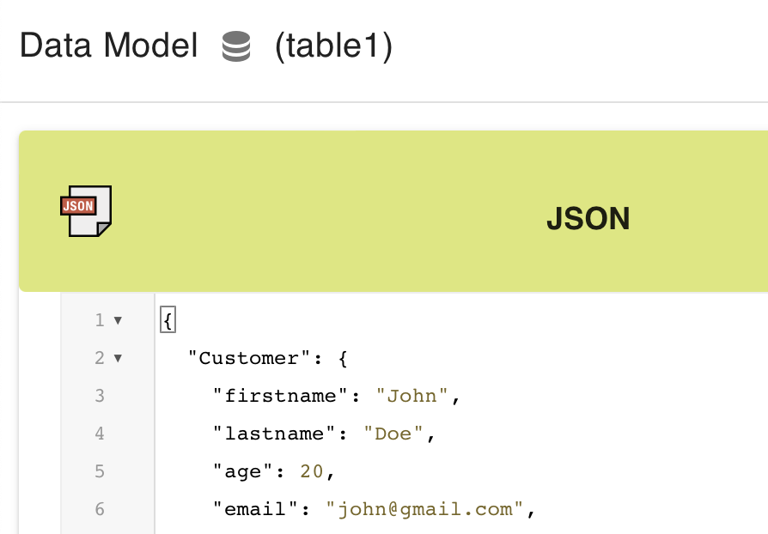
Data Modeling Tool (Data Accessibility Lab)
Second, create Data Setup to “FoodSale” and Process/Table Name to “FoodOrder”

Slide 11
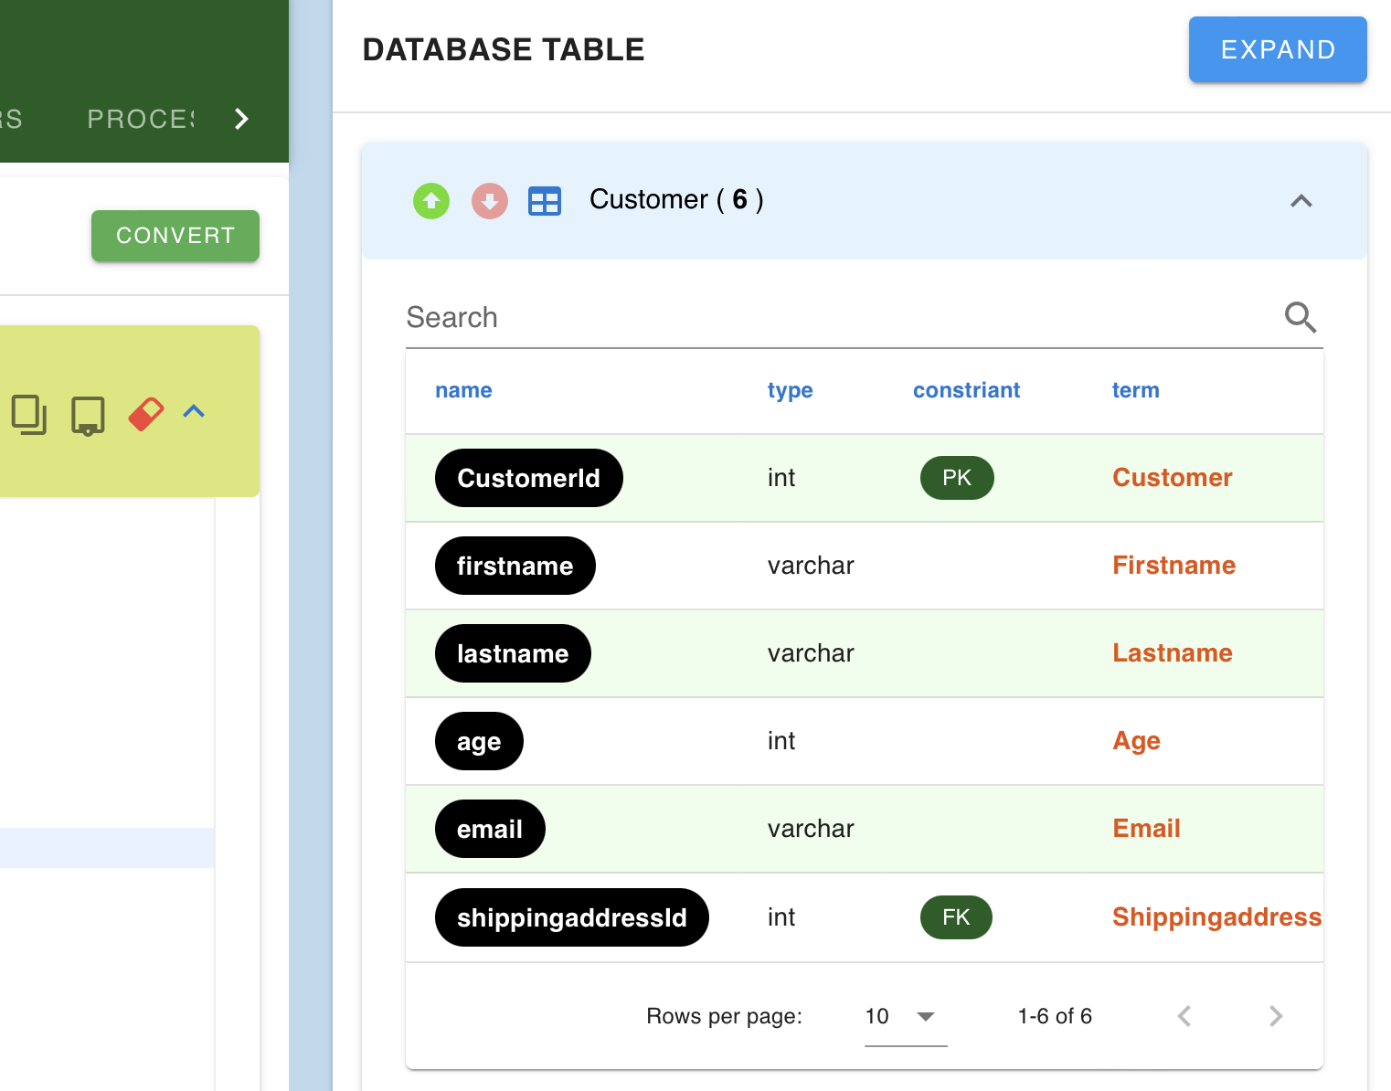
Data Modeling Tool (Data Accessibility Lab)
Third, click convert button to provide database table

Slide 12
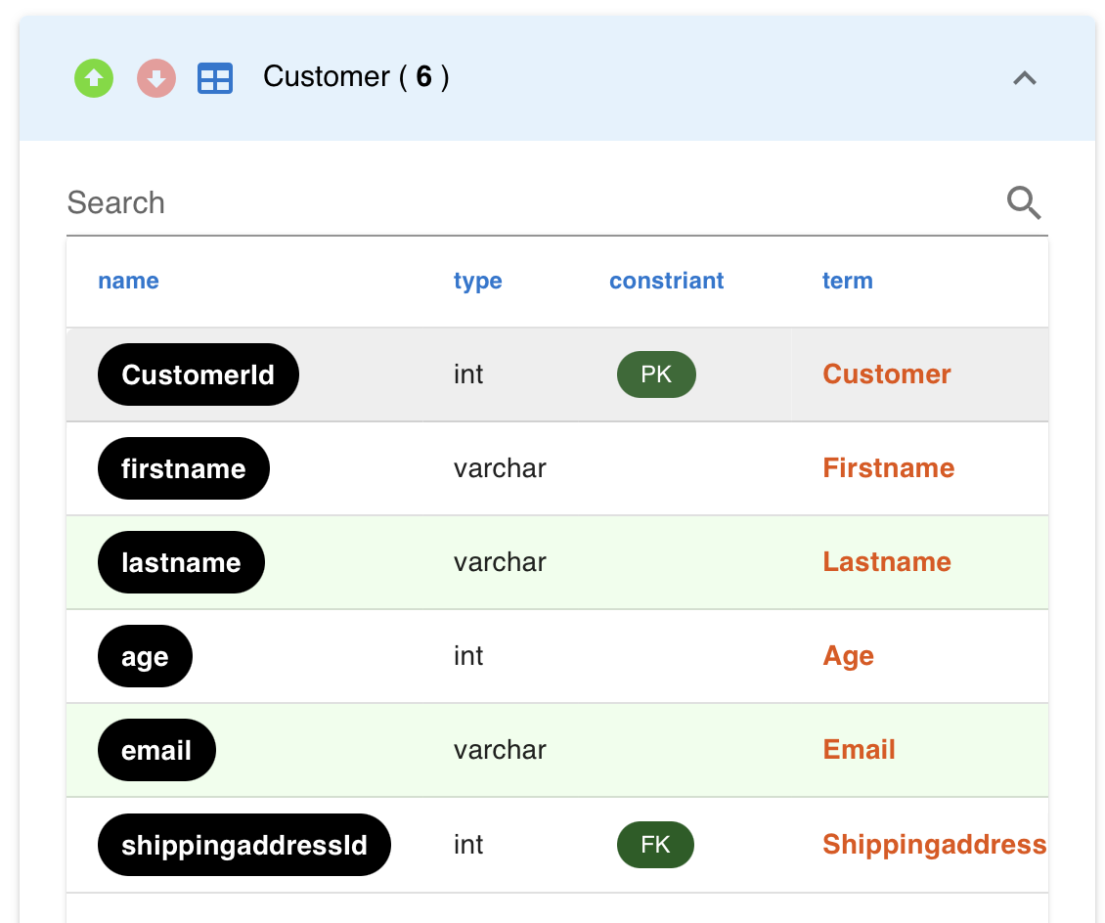
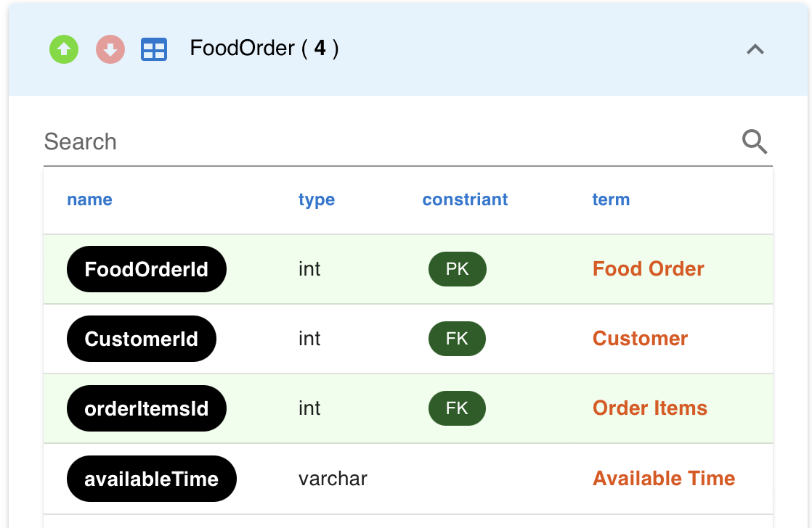
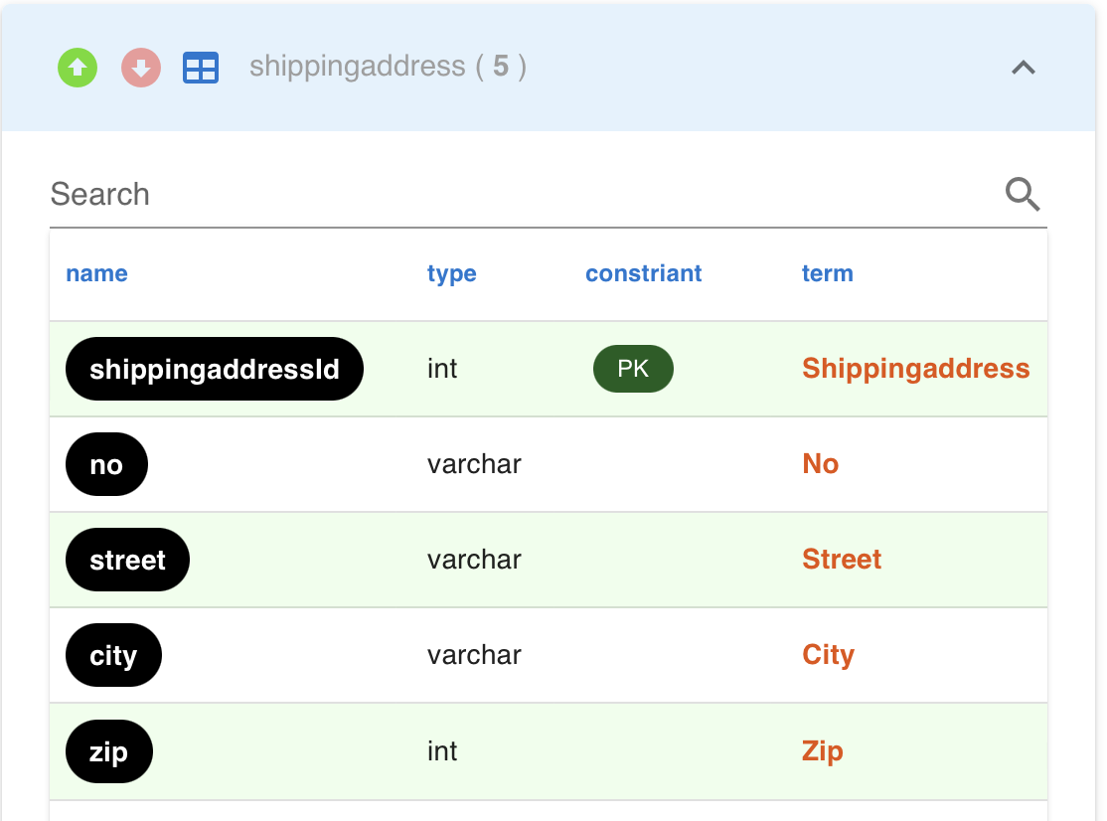
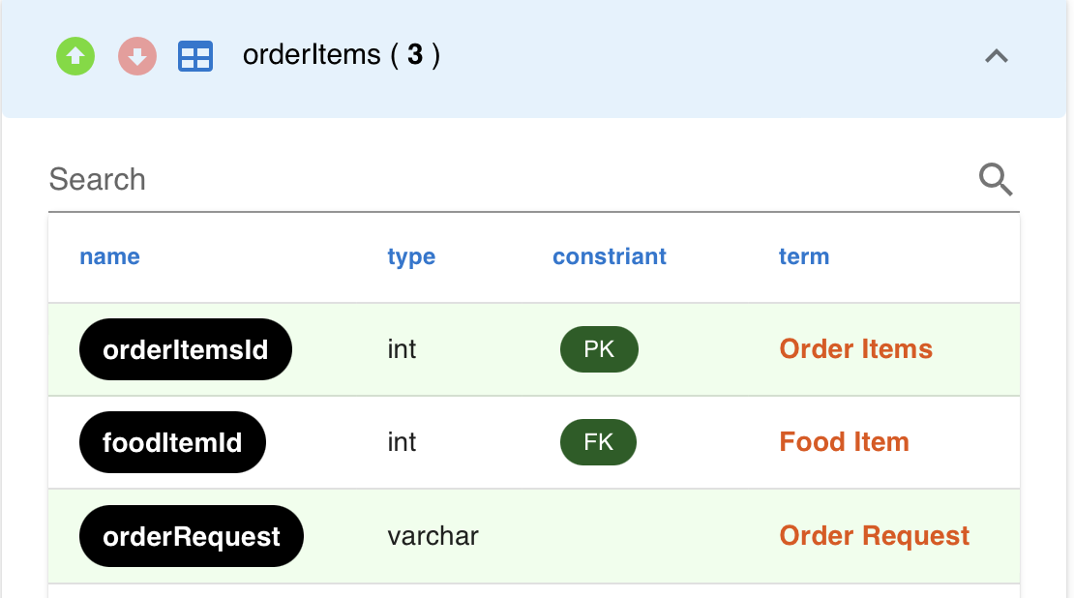
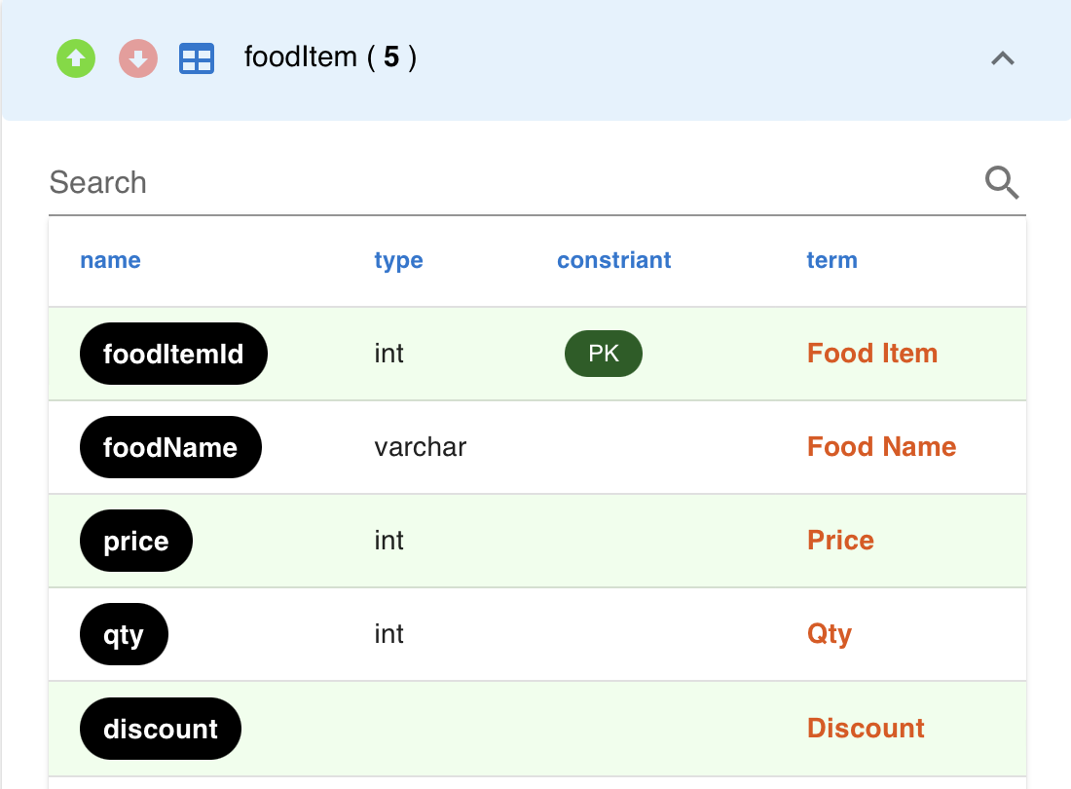
Data Modeling Tool (Data Accessibility Lab)
Food Order Table List and Relationship (In DBM Tool)
How the currently JSON Food Order is different from the previous one?

Slide 13
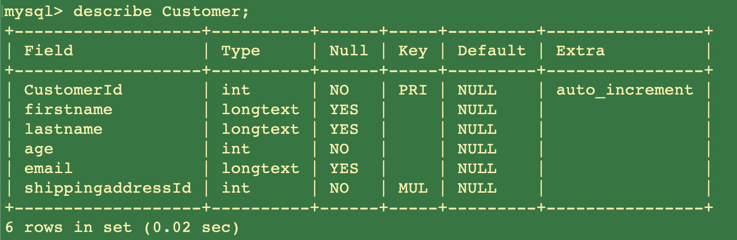
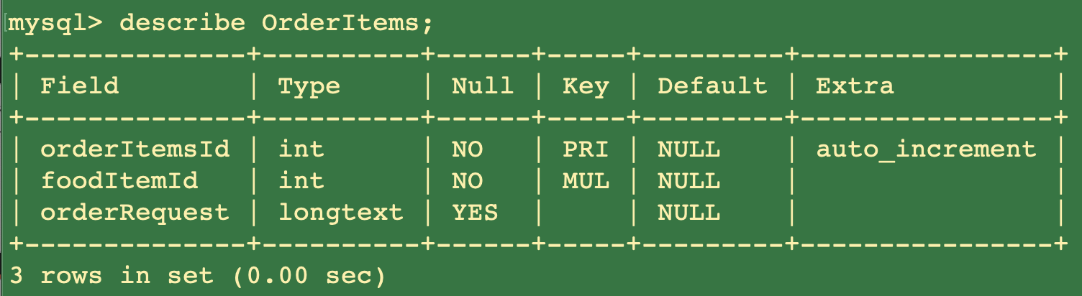
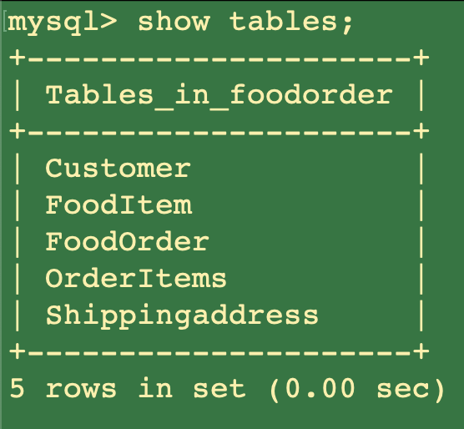
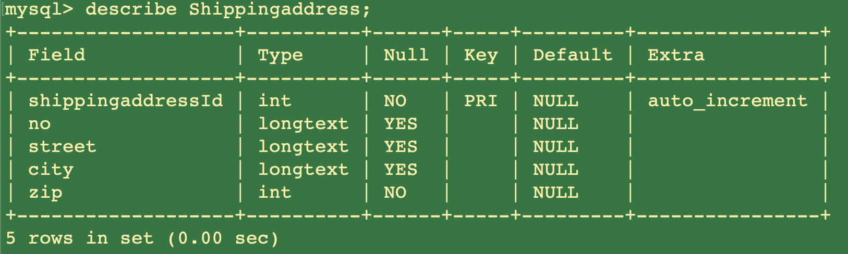
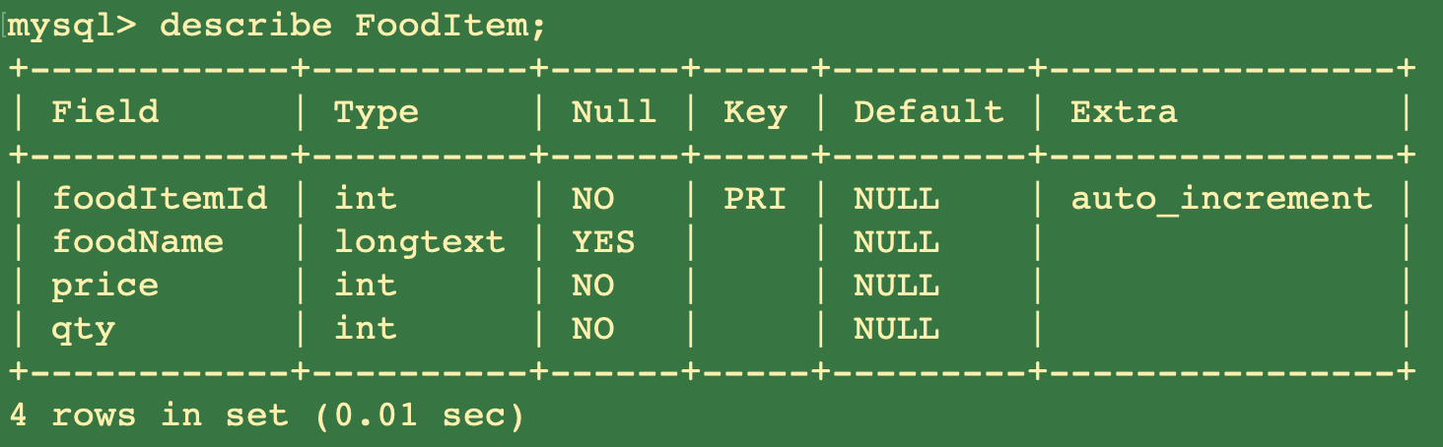
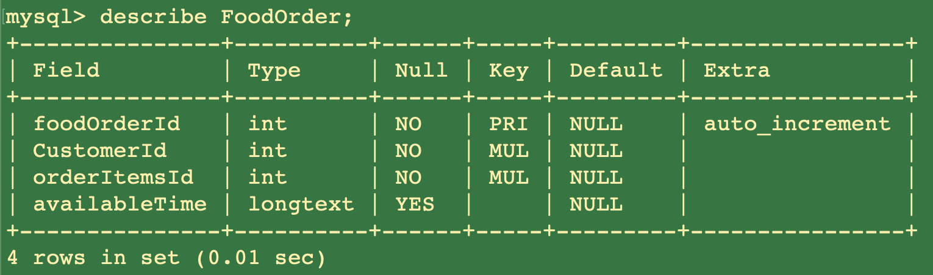
Data Modeling Tool (Data Accessibility Lab)
When we bring SQL converted and try to import this into mySQL …
How the currently JSON Food Order is different from the previous one?

Slide 14
Data Modeling Tool (Data Accessibility Lab)
Forth, let’s check the data accessibility inside Food Sale
What are the departments inside food sale?
Who has the roles inside food sale?
Who has the positions inside food sale?
Who are the users inside food sale?
What are the assets (report/document/dashboard) inside food sale?
What are data element catalogs (in each field) including general information, business detail, business assets, and UI inside food sale?
Try to questions and answers by yourself ...
(giving for 20 minutes to list the answers)

Slide 15
Data Modeling Tool (Data Accessibility Lab)
The process of input data accessibility would be look like …
Positions
Roles
Departments
Users
Assets
Catalog

Slide 16
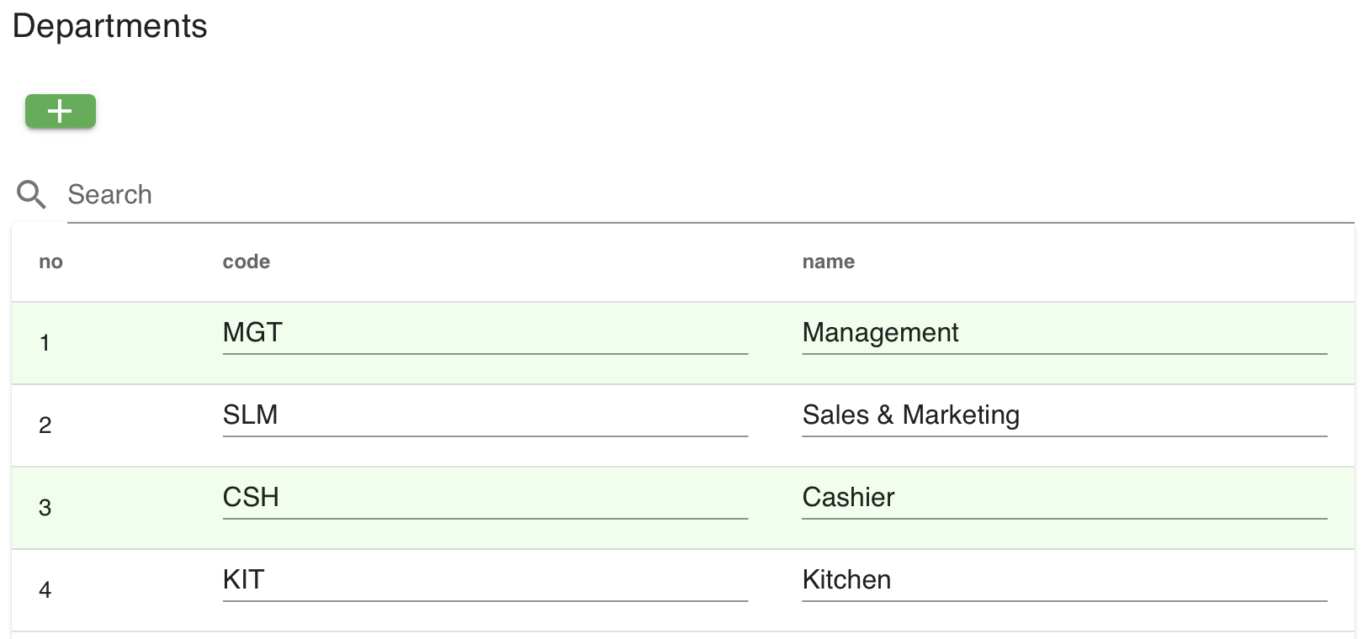
Data Modeling Tool (Data Accessibility Lab)
Fifth, let’s try to input departments inside Food Order

Slide 17
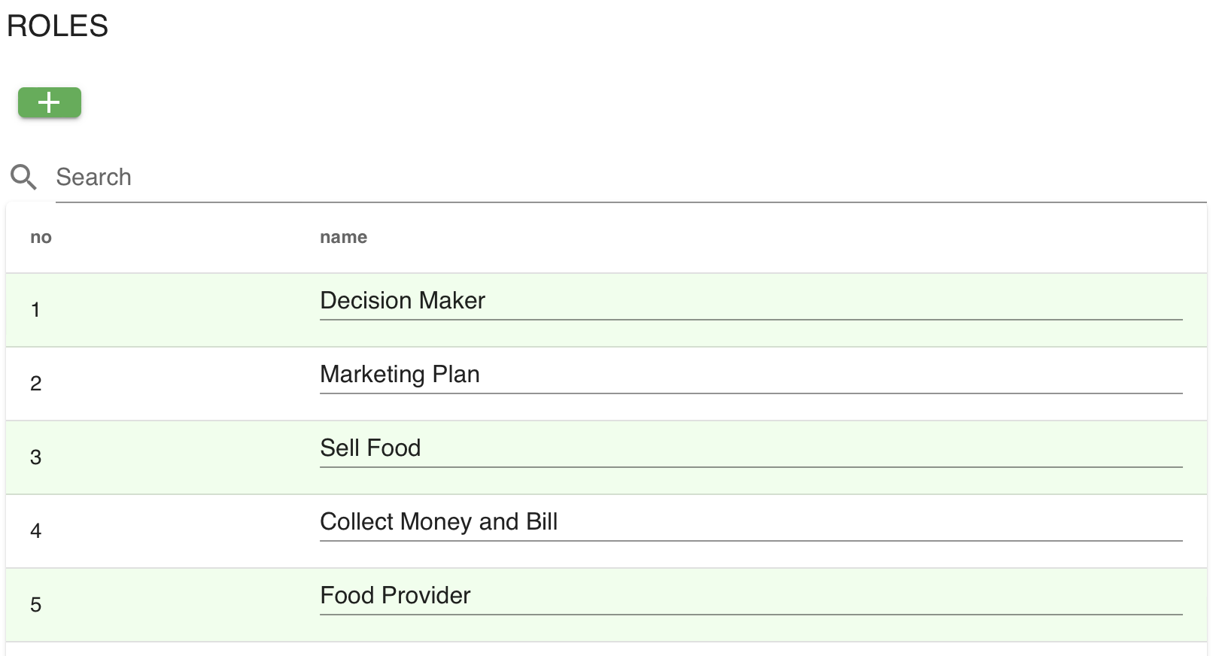
Data Modeling Tool (Data Accessibility Lab)
Sixth, let’s try to input roles inside Food Order

Slide 18
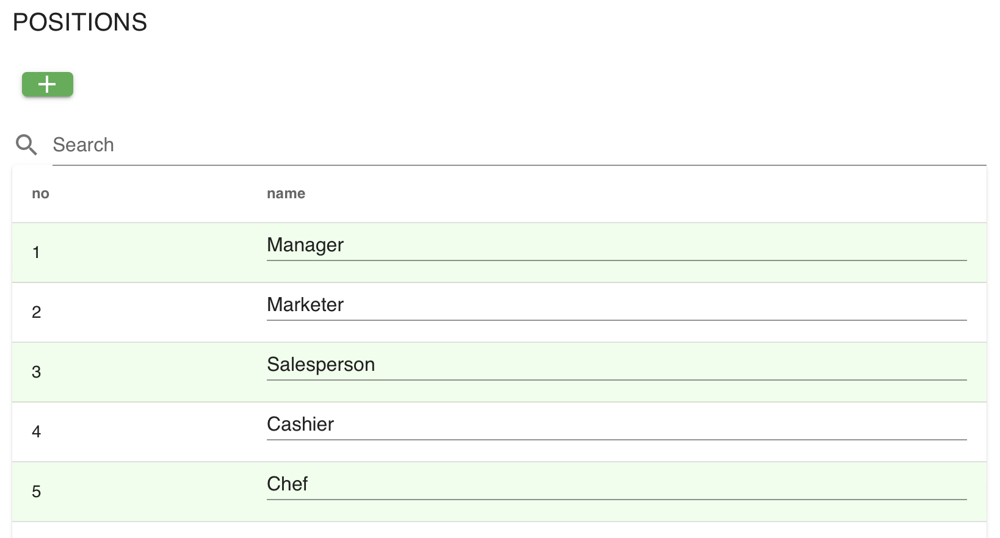
Data Modeling Tool (Data Accessibility Lab)
Seventh, let’s try to input positions inside Food Order

Slide 19
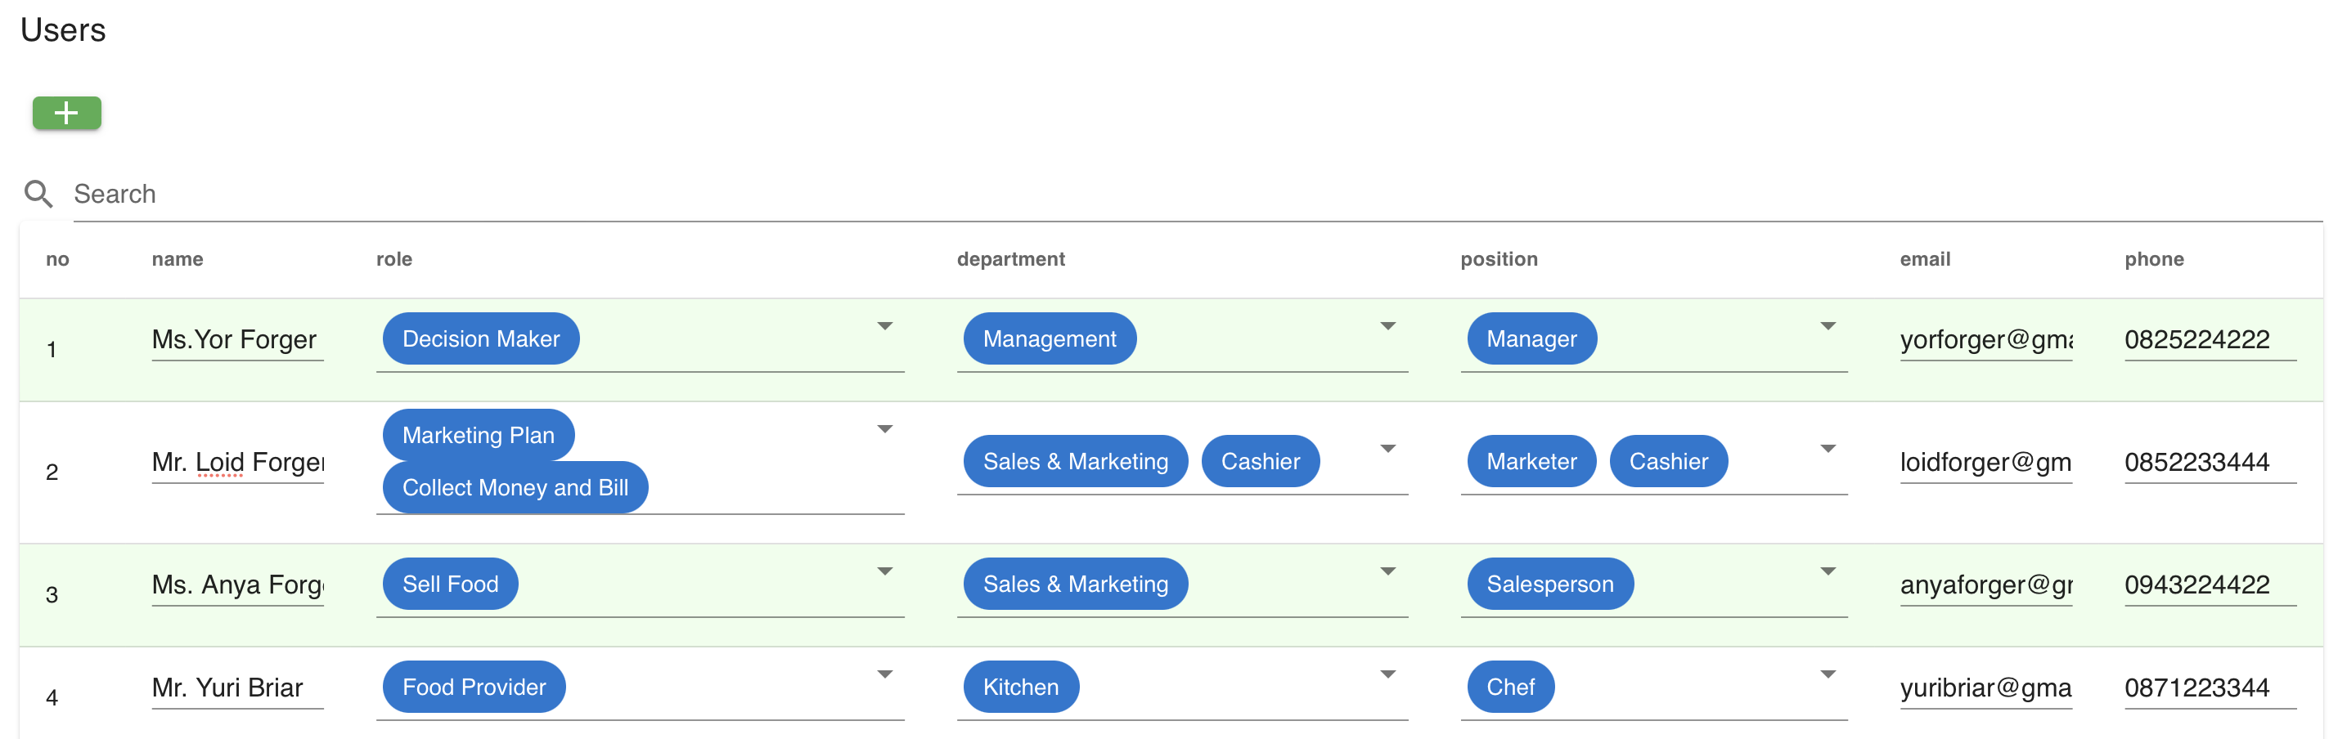
Data Modeling Tool (Data Accessibility Lab)
Eighth, let’s try to input users inside Food Order

Slide 20
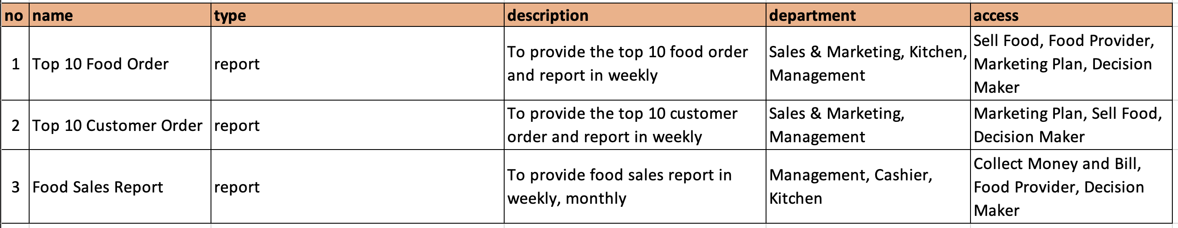
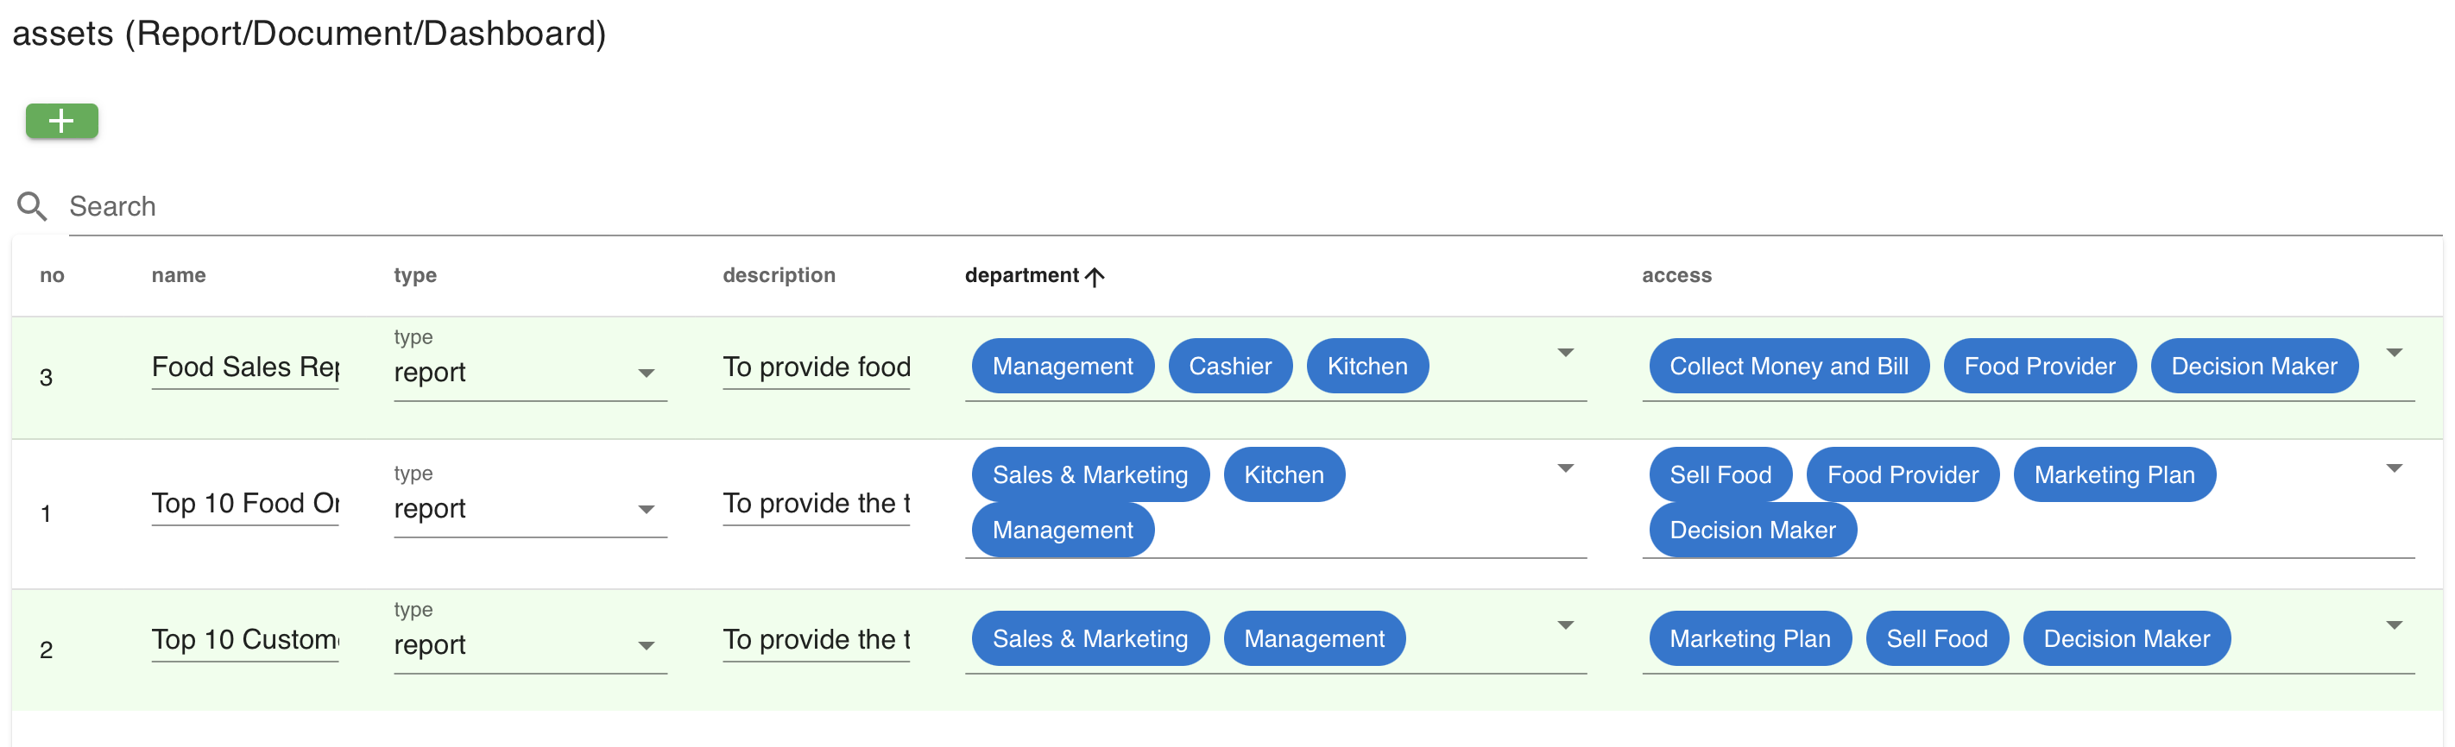
Data Modeling Tool (Data Accessibility Lab)
Ninth, let’s try to input assets (report/document/dashboard) inside Food Order

Slide 21
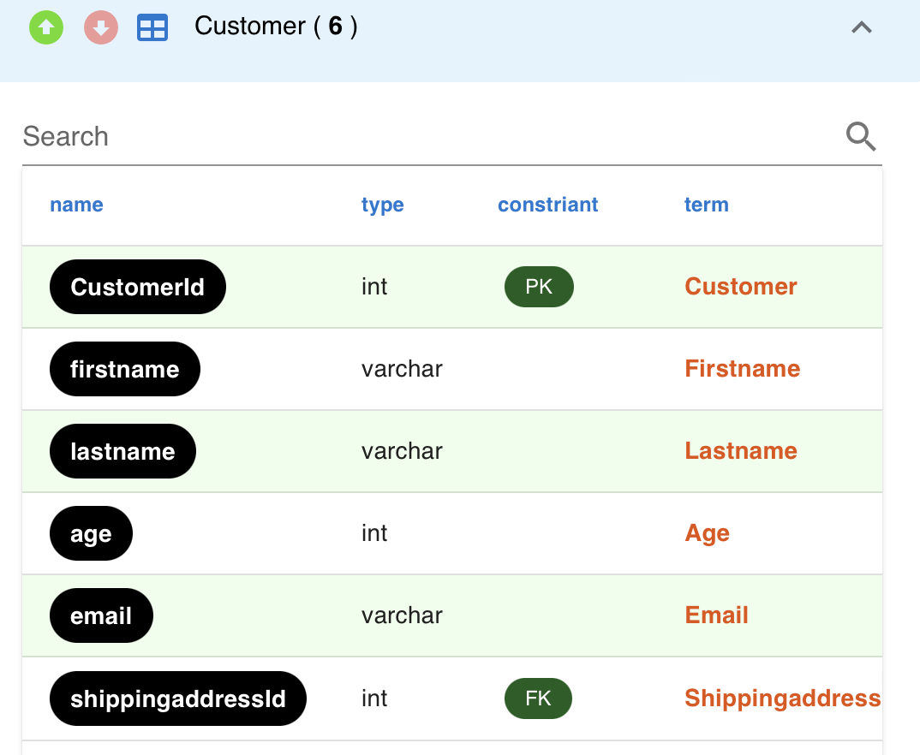
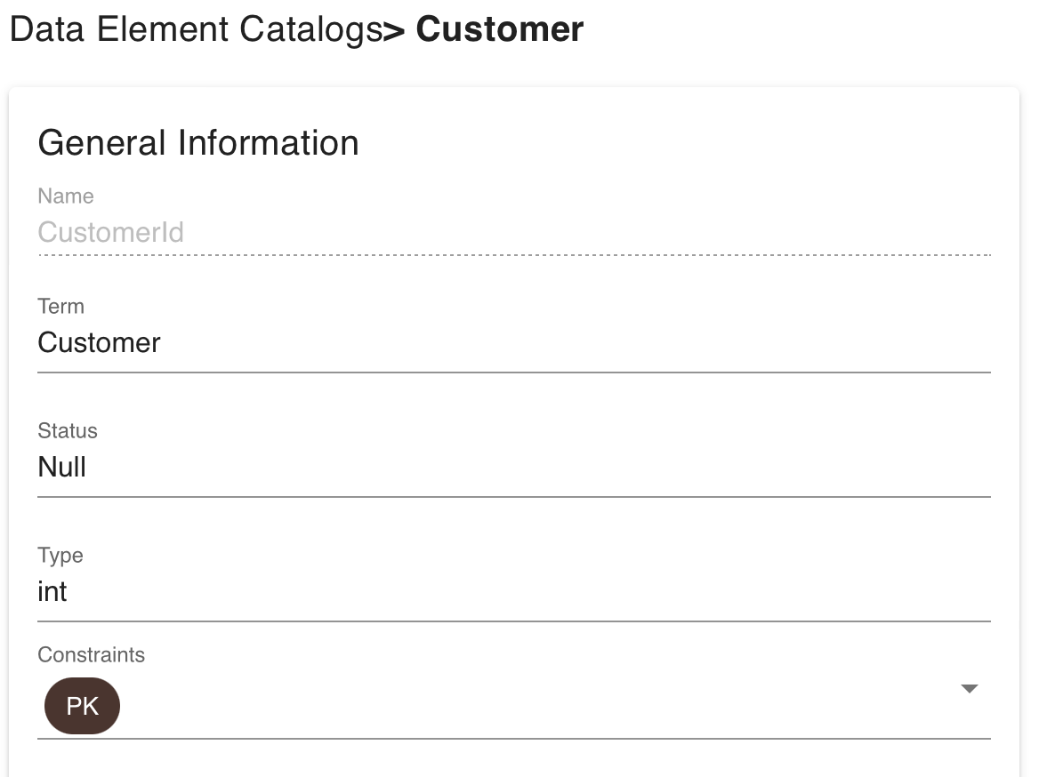
Data Modeling Tool (Data Accessibility Lab)
Tenth, let’s try to check Data Catalog for each field in every tables and input the summary inside General Information, Business Detail, Business Assets, and UI (e.g., click CustomerId to display data element catalogs and input information)

Slide 22
Data Modeling Tool (Data Accessibility Lab)
Summary inside CustomerId’s Data Catalog (1)
Let’s try to check other Data Catalogs and input the summary …

Slide 23
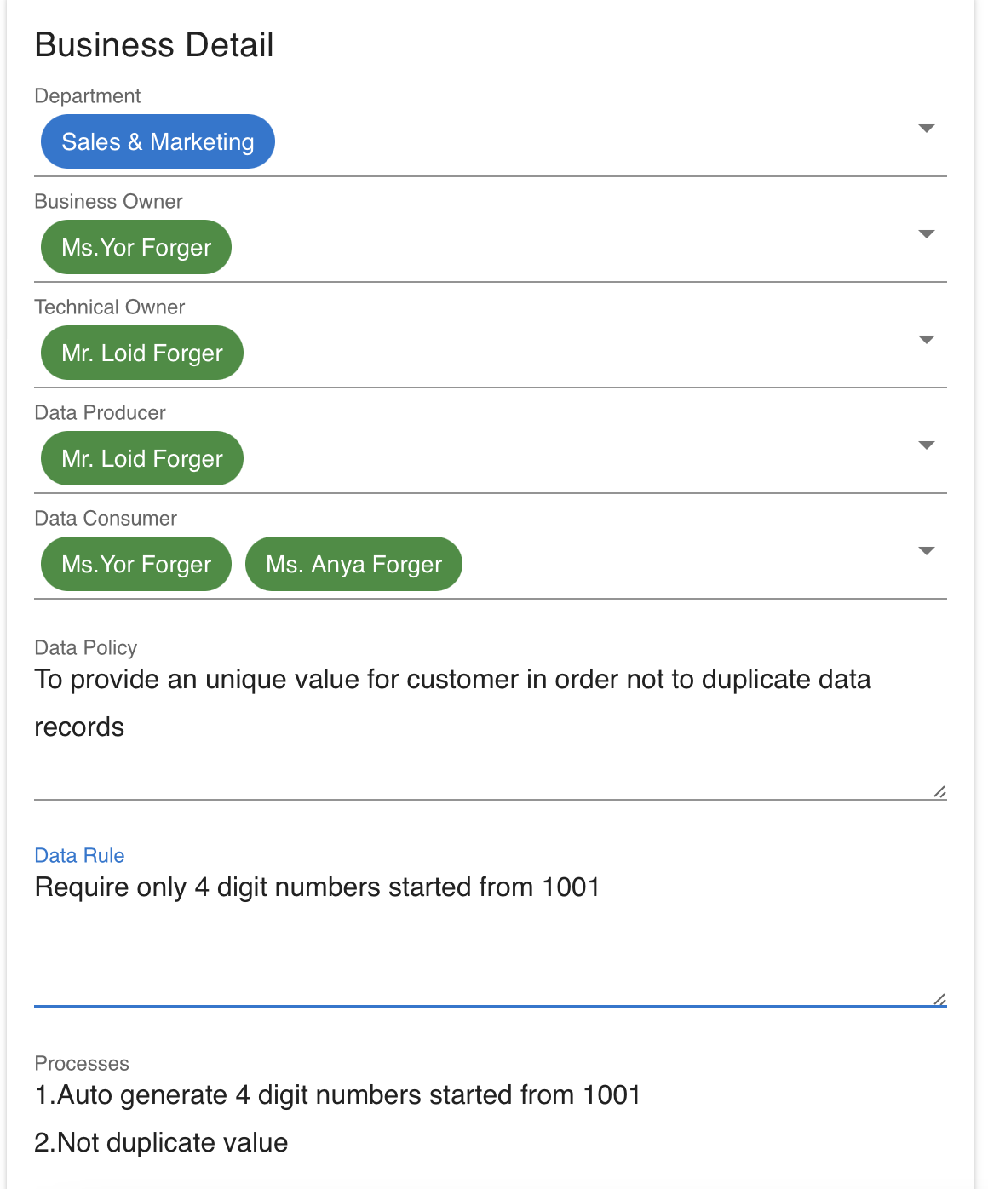
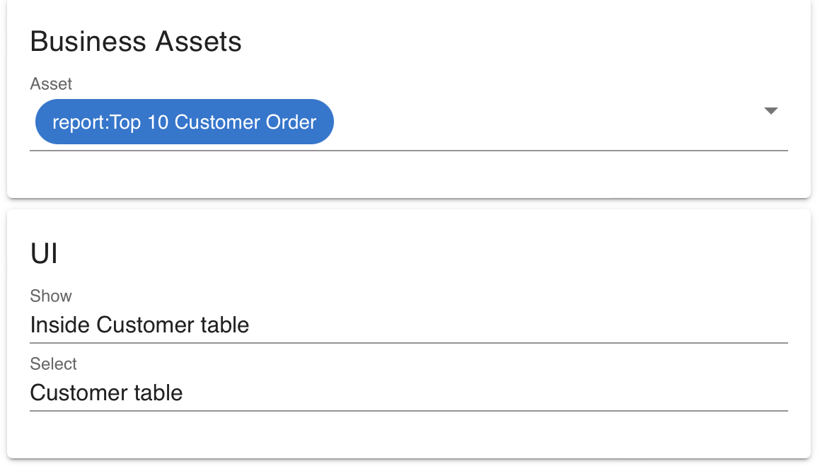
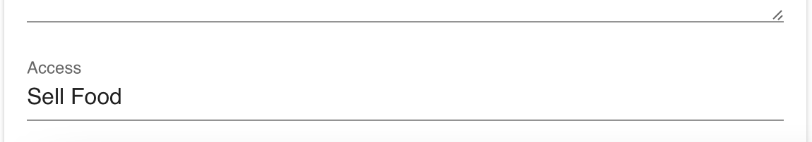
Data Modeling Tool (Data Accessibility Lab)
Summary inside CustomerId’s Data Catalog (2)
Let’s try to check other Data Catalogs and input the summary …

Slide 24
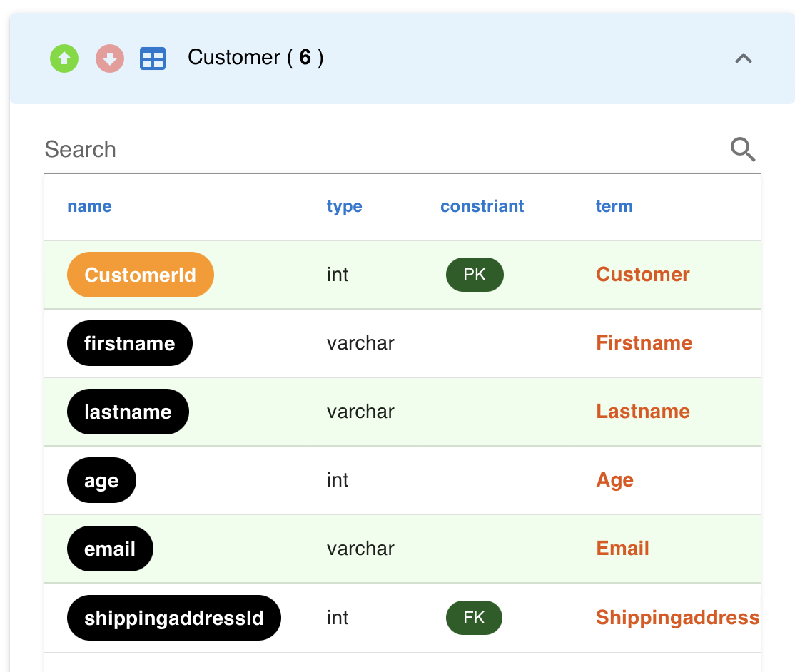
Data Modeling Tool (Data Accessibility Lab)
When you complete to input one data catalog for CustomerId, the field color is changed from black to orange
Let’s try to check other Data Catalogs and input the summary …

Slide 25
Data Modeling Tool (Data Accessibility Lab)
When you finish the summary …
Export file to “json.txt” and try to rename to another name (e.g., FoodOrder-json.txt)
In the future, you can import this file again by copy & paste the syntax into import dialog
Review Data Model Diagram slide no. 29-31 again

Slide 26
Data Modeling Tool (Data Accessibility Lab)
Let’s try this (in class)
Review the JSON syntax in what you have done and save from the car rental business in Data Modeling Diagram using DBM Tool
Provide the Data Accessibility inside the car rental business follow these questions:
What are the departments inside car rental?
Who has the roles inside car rental?
Who has the positions inside car rental?
Who are the users inside car rental?
What are the assets (report/document/dashboard) inside car rental?
What are data element catalogs (in each field) including general information, business detail, business assets, and UI inside car rental?
Export file into “json.txt” and rename file to “CarRental-json.txt”

